Slide 1
Operating Systems
SENS-3513
Week: 13
Deadlocks
Operating System Concepts
9th edition
Silberschatz, Galvin & Gagne
John Wiley & Sons
2013
Dr Nauman Mazhar
Faculty of Information Technology (FIT)
University of Central Punjab (UCP)

Slide 2
Objectives
Deadlocks
Basic concepts
Deadlock Characterization
  Resource Allocation Graph (RAG)
Deadlock Handling Techniques
  Prevention
  Avoidance (Banker’s Algorithm)
  Detection and Recovery
  Ignore
2

Slide 3
Deadlock Problem
Deadlock
A situation where a set of processes or threads are unable to proceed because:
  each process is holding a resource, and is waiting to acquire a resource held by another process in the set
  each process is waiting for an event, that can only be caused by another process within the set
Can occur in concurrent systems – multitasking/multi-threaded environment
  creates a cycle of dependencies that cannot be resolved
3

Slide 4
Deadlock Problem
Examples:
A table with a writing pad and pen; two persons sitting around the table want to write letter; one picks up the pad and the other grabs the pen; causes deadlock
Two cars crossing a single lane bridge, from opposite directions
A person going down a ladder, while another person is climbing up the ladder
Consider a system having 2 processes & 2 tape drives
  P1 & P2 each hold one tape drive
  and each process needs the other tape drive too
    e.g, to copy data from one tape drive to another
4

Slide 5
Deadlock Problem
Consider two semaphores, s1 & s2, each initialized to 1
P₀ P₁
wait (s1); wait (s2);
wait (s2); wait (s1);
. .
. .
. .
signal (s1); signal (s2);
signal (s2); signal (s1);
. .
. .
. .
signal (s₁)
P₀
P₁
signal (s₂)
5

Slide 6
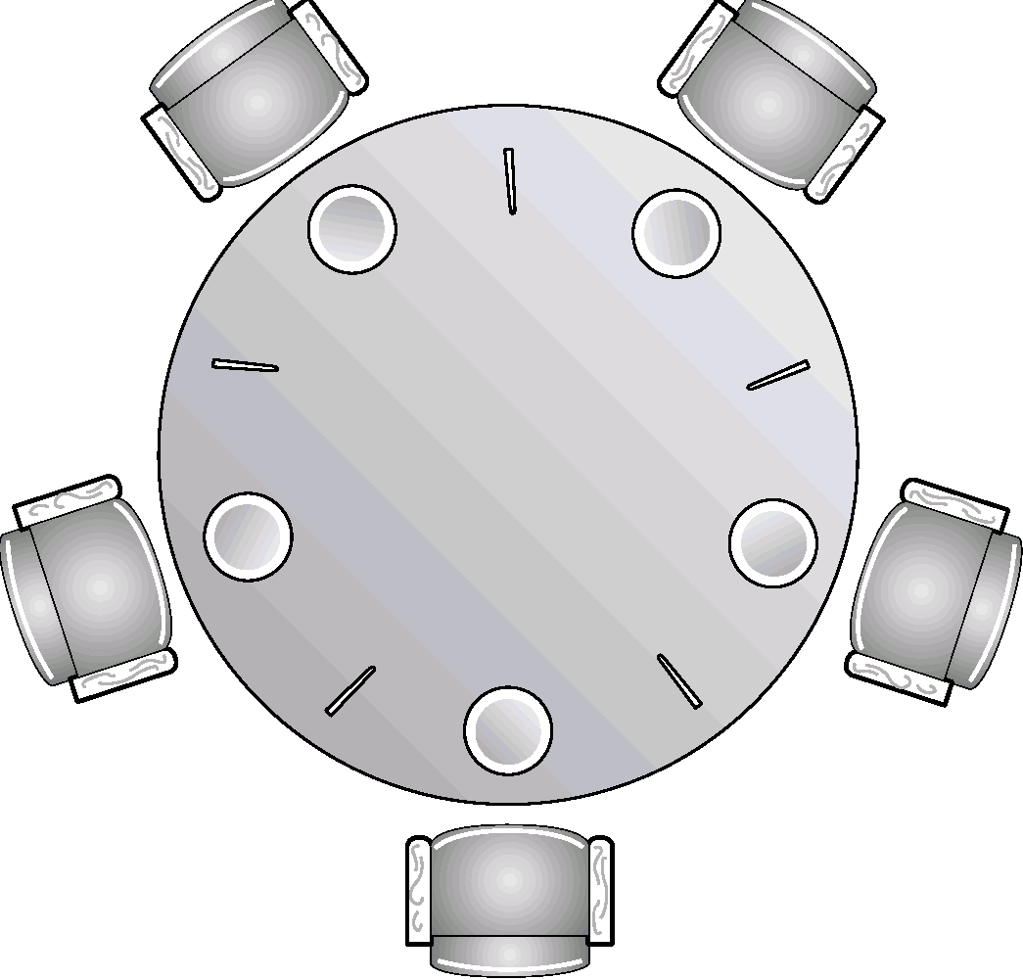
Deadlock Problem
Dining Philosophers Problem
Consider the dining philosophers problem
All five philosophers become hungry at the same time
All pick up chopsticks on their left
All now look for the right one,
which is being held by neighboring
philosopher
No one puts the chopstick back
All keep waiting for the right
chopstick
6

Slide 7
Resources
Deadlocks involve resources, which can be…
  hardware device – tape drive, printer, memory, CPU
  piece of info – variable, file, semaphore, DB record
Preemptable Resources
  can be taken away from process, with no ill effects
  sharable resources; CPU, memory
Non-Preemptable Resources
  cannot be taken away from a process, w/o causing problems
  non sharable resources; if process is burning a CD ROM, taking it back & giving to other process, will result in garbled CD
In general, DL involves Non-Preemptable resources
7

Slide 8
Conditions for Deadlock
Deadlock arises, if four necessary conditions occur together:
Mutual exclusion: only one process can use a resource at
any time
Hold & wait: a process holds one or more resources, while waiting for others to be allocated
Non-preemption: resource cannot be taken away forcibly from
a process holding it
Circular wait: there is a set of waiting processes {P₀, P₁, …, P_{n}}, such that:
  P₀ → waiting for resource held by P₁
  P₁ → waiting for resource held by P₂
  P_{n–1} → waiting for resource held by P_{n}
  P_{n} → waiting for resource held by P₀
8

Slide 9
  Deadlock Characterization:
  Resource Allocation Graph
  (RAG)
9

Slide 10
Deadlock Characterization
Resource Allocation Graph (RAG)
  RAG is a tool used to describe deadlocks
  RAG comprises a set of vertices V, and a set of edges E
  V is partitioned into two types:
    Processes P = {P1, P2, …, Pn} represented as circles
    Resources R = {R1, R2, …, Rm} represented as rectangles
  E can also be of two types:
    Request Edge : Pi → Rj
    Assignment Edge : Rj → Pi
R
P
10

Slide 11
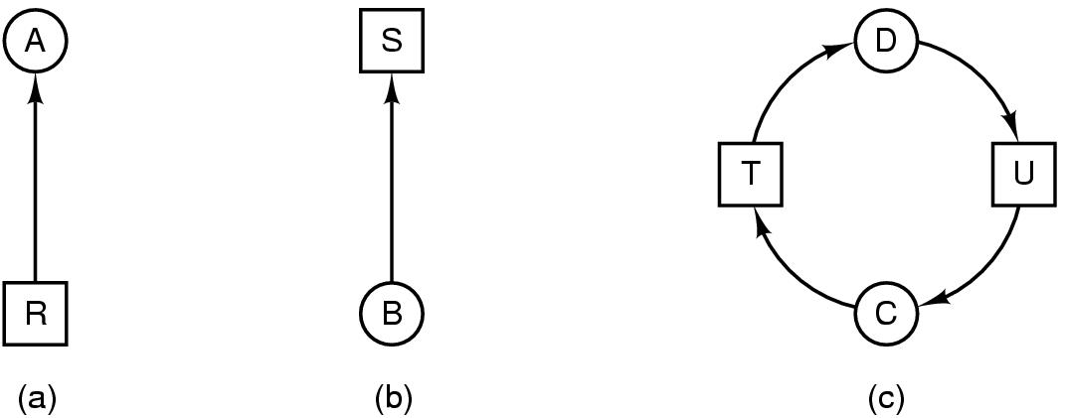
Resource Allocation Graph
Each process Requests and is Assigned a resource…
Modeled with directed graphs
  Resource R assigned to process A
  Process B has requested, & is waiting for resource S
  Process C & D are in deadlock, over resources T & U
  (if graph contains a cycle, deadlock may exist)
11

Slide 12

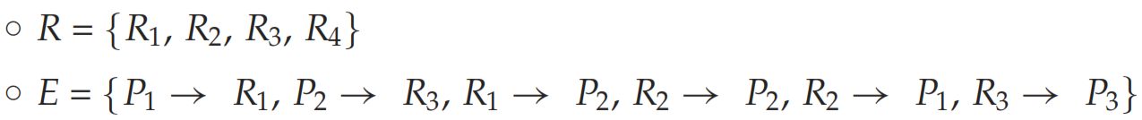
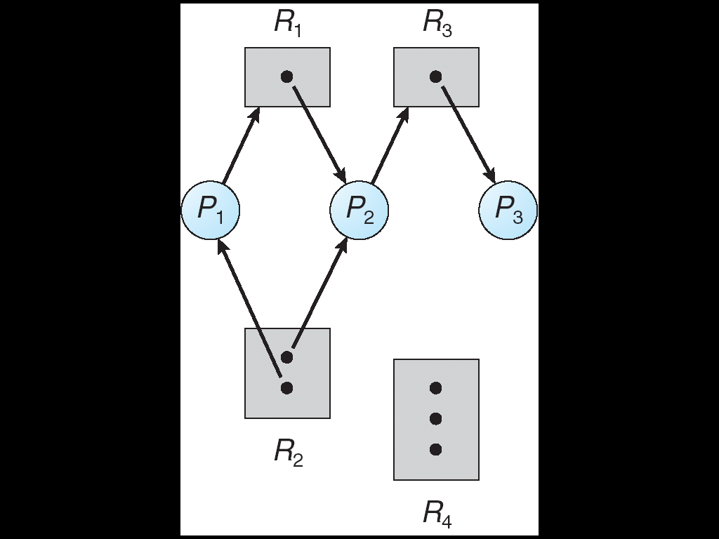
Resource Allocation Graph – w/o Deadlock
RAG contains no cycle, and no deadlock exists
12

Slide 13
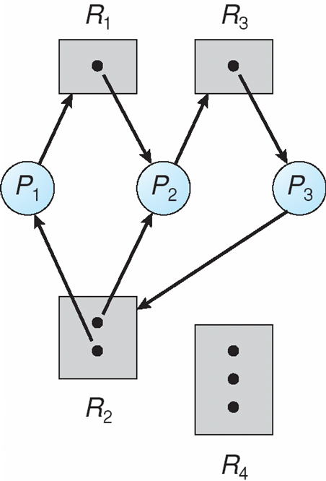
Resource Allocation Graph - with Deadlock
Consider process P3 requests an instance of resource type R2
Add request edge in graph
P3 → R2
No instance of R2 readily
available
Two cycles in system…??
Processes P1, P2 & P3 are
in deadlock
13

Slide 14


RAG With a Cycle - No Deadlock
Consider the resource allocation graph, with a cycle…
Cycle, but NO deadlock
process P4 may release its
instance of R2
R2 can then be allocated to P3
breaks the cycle
14

Slide 15
Basic Facts
If RAG contains no cycles…
  no deadlock
If RAG contains a cycle…
  if only one instance per resource type
    then deadlock
  if several instances per resource type
    possibility of deadlock
15

Slide 16
Sample Problem
Problem 1
A system has four processes P1 thru P4, and two resource types
R1 & R2. It has 2 units of R1, and 3 units of R2.
Given that:
    P1 requests 2 units of R2, and 1 unit of R1
    P2 holds 2 units of R1, and 1 unit of R2
    P3 holds 1 unit of R2
    P4 requests 1 unit of R1
  Draw the RAG for this state of the system
    is the system in deadlock
    if so, which process(es) are involved
    (there is No Deadlock in the system…!!)
16

Slide 17

Deadlock Solutions
Generally speaking we can deal with Deadlock problem in one of three ways:
  Ensure that system will never enter deadlock state
  (a) Prevention (b) Avoidance
  Allow system to enter deadlock state & then recover
  (c) Detection & Recovery
  Ignore the problem & pretend that deadlocks never occur
  (d) Do nothing
17

Slide 18
Deadlock Solutions
Prevention
  Design the system so that deadlock is impossible
  disallow one of four conditions for deadlock
Avoidance
  Steer around deadlock with smart scheduling
  make dynamic choices that help avoid deadlocks
Detection & recovery
  Check for deadlocks periodically, & apply recovery
  abort deadlocked process, release resources
Do nothing
  Prevention, avoidance and detection/recovery are expensive
  If deadlock is rare, is it worth the overhead…??
  Manual intervention, if needed
  kill processes, reboot system
18

Slide 19
  Prevention
19

Slide 20
Deadlock Prevention
Restrain how Resource Requests can be allocated…
“Ensure that at least
one of the four necessary conditions for deadlocks
is violated”
  Mutual Exclusion
  Hold & Wait
  No Preemption
  Circular Wait
20

Slide 21
Deadlock Prevention
Deny Mutual Exclusion :
Denying mutual exclusion can help with DL
But not possible to totally prevent deadlocks, by denying mutual exclusion condition alone
  certain resources are non-sharable
  cannot deny mutual exclusion for non-sharable resource,
  mutex, semaphores, printers, etc
  if process A holds mutex 1 and waits for mutex 2,
  while process B holds mutex 2 and waits for mutex 1,
  both will be stuck in a deadlock
  cannot preempt a process that has printed half a page
  and give the printer to another process
21

Slide 22
Deadlock Prevention
Deny Hold & Wait :
We must guarantee that whenever a process requests a resource, it is not holding any other resource
Option 1
  process be allocated all requested resources, before it starts
  but allocated resources may remain unused for long period
  (low resource utilization)
Option 2
  process must release all resources it currently holds, before it can request additional resources
  ensures process cannot hold resource while waiting for others
  (starvation possible)
22

Slide 23
Deadlock Prevention
Allow Preemption :
If process is holding some resource, & requests another resource that cannot be allocated immediately, then all resources currently held are preempted
  process restarted only when it can be allocated all required resources – old as well as new ones
Protocol often applied to resources, whose state can be saved & restored, easily
preemptable resources, e.g, CPU registers & memory space
Cannot be applied to resources, like printers & tape drives
  difficult to take tape drive away from a process
  that is busy writing a tape
23

Slide 24
Deadlock Prevention
Break Circular Wait : (Sol - 1)
In resource allocation diagram
process with an outgoing link, must have no incoming links
  cannot have a loop…!
Process
request
Resource
assignment
24
Notes:
This resource allocation diagram shows a deadlocked state. Among the request edges (blue), which of these requests would the processes not have been able to make according to the “No hold and wait” rule?

Slide 25
Deadlock Prevention
Break Circular Wait : (Sol - 1)
In resource allocation diagram
process with an outgoing link, must have no incoming links
  cannot have a loop…!
Legal Links are:
Process
request
Resource
assignment
25
Notes:
This resource allocation diagram shows a deadlocked state. Among the request edges (blue), which of these requests would the processes not have been able to make according to the “No hold and wait” rule?

Slide 26
Deadlock Prevention
Break Circular Wait : (Sol - 1)
In resource allocation diagram
process with an outgoing link, must have no incoming links
  cannot have a loop…!
Legal Links are:
Very constraining
often need more than one resource
hard to predict at the beginning what all resources you’ll need
releasing & re-requesting is inefficient
  complicates programming, might lead to starvation
26
Notes:
This resource allocation diagram shows a deadlocked state. Among the request edges (blue), which of these requests would the processes not have been able to make according to the “No hold and wait” rule?

Slide 27
Deadlock Prevention
Break Circular Wait : (Sol - 2)
Break circular wait by requesting resources in order
  assign a unique number to each resource type
  each process can request resources only in increasing order of enumeration
Example
  Consider processes P1 & P2
  Resources: Tape drive = 1, Disk drive = 5, Printer = 12
    P1 holding Tape, can request both DD & Printer
    P2 holding DD, can request Printer, but not TD
27

Slide 28
Ordered Resource Requests prevent DL
Without numbering
Cycle!
request
assignment
28

Slide 29
Ordered Resource Requests prevent DL
With numbering
4
3
8
7
Contradiction:
Must have requested 3 first!
request
assignment
29

Slide 30
Are we always in trouble without ordering resources…?
Ordered Resource Requests prevent DL
No, not always:
Ordered resource requests are sufficient to avoid deadlock, but not necessary
Convenient, but may be conservative…!
4
3
8
7
30

Slide 31
  Avoidance
31

Slide 32
Deadlock Avoidance
Deadlock avoidance is different from deadlock prevention
  Allow the necessary conditions for deadlock,
  but dynamically allocate resources such that deadlock never occurs
Two approaches:
  Do not start a process if its demands might lead to
  deadlock
  strategy is conservative, and thus inefficient
  Do not grant a resource request if this allocation might
  lead to deadlock
  request is granted only if some allocation of remaining free
  resources is sufficient to allow all processes to complete
32

Slide 33
Deadlock Avoidance
Deadlock avoidance requires information about future use of resources by processes
  each process declares max number of resources of each type
  it may need
Resource Allocation State
  total number of resources available in system
  max demand of processes
  number of resources currently allocated to processes
“DL avoidance algo dynamically examines
Resource Allocation State and ensures there can never be
circular-wait condition”
33

Slide 34
Deadlock Avoidance
Safe State
when process requests an available resource, system must decide
if its allocation leaves system in safe state
System is in safe state,
if at least one resource allocation sequence exists
that does not result in DL
  system in Safe state ⇒ no deadlocks
  system in Unsafe state ⇒ possibility of deadlock
Safe Sequence
sequence of execution of processes in which OS can meet resource requests of all processes, and still avoid DL
DL Avoidance ensures system never enters Unsafe state
34

Slide 35
Sample Problem 1
Consider a system having 12 tape drives
There are 03 processes, which need to use these tape drives
Current system state is as shown:
Process | Max Need | Allocated
P₀ | 10 | 5
P₁ | 4 | 2
P₂ | 9 | 2
Is the system in safe state; if yes, give a safe sequence.
35

Slide 36
Sample Problem 1 - solution
Process | Max Need | Allocated
P₀ | 10 | 5
P₁ | 4 | 2
P₂ | 9 | 2
Total Tape Drives: 12 Total Allocated: 9 Available = 3
Process | Curr Need
P₀ | 5
P₁ | 2
P₂ | 7
Safe Sequence: <P1, P0, P2>
36

Slide 37
Sample Problem 2
Assuming that P2 requests and is allocated one more instance
of tape drive. The new system state will be:
Process | Max Need | Allocated
P₀ | 10 | 5
P₁ | 4 | 2
P₂ | 9 | 3
Is the system in safe state. If yes, give a safe sequence.
If not, explain which process may cause a deadlock.
37

Slide 38
Sample Problem 2 - solution
Process | Max Need | Allocated
P₀ | 10 | 5
P₁ | 4 | 2
P₂ | 9 | 3
Total Tape Drives: 12 Total Allocated: 10 Available = 2
Process | Curr Need
P₀ | 5
P₁ | 2
P₂ | 7
Safe Sequence: <P1, ????>
P0 & P2 are in deadlock…!
38

Slide 39
Sample Problems
Problem 1
Consider a system consisting of four resources of same type that are shared by three processes, each of which needs at most two resources. Show that system is deadlock free.
Problem 2
A system has two processes and three identical resources. Each process needs a maximum of two resources. Is deadlock possible. Explain your answer.
39

Slide 40
Deadlock Avoidance Approaches
Resource Allocation Graph (RAG) algorithm
  DL avoidance when there is a single instance of each resource type
  uses a variant of RAG
Banker’s Algorithm
  DL avoidance when there are multiple instances of each resource type
40

Slide 41
RAG Algorithm
In addition to Request & Assignment edge, RAG algo makes use of Claim edge
Claim edge Pi Rj indicates future requirement of process:
“process Pi may request an instance of resource Rj
some time in future”
  when process makes request for resource
  Claim edge is converted to Request edge
  when resource is assigned to a process
  Request edge is converted to Assignment edge
Processes inform their resource needs in advance
before Pi starts execution, its claim edges must appear in RAG
41

Slide 42
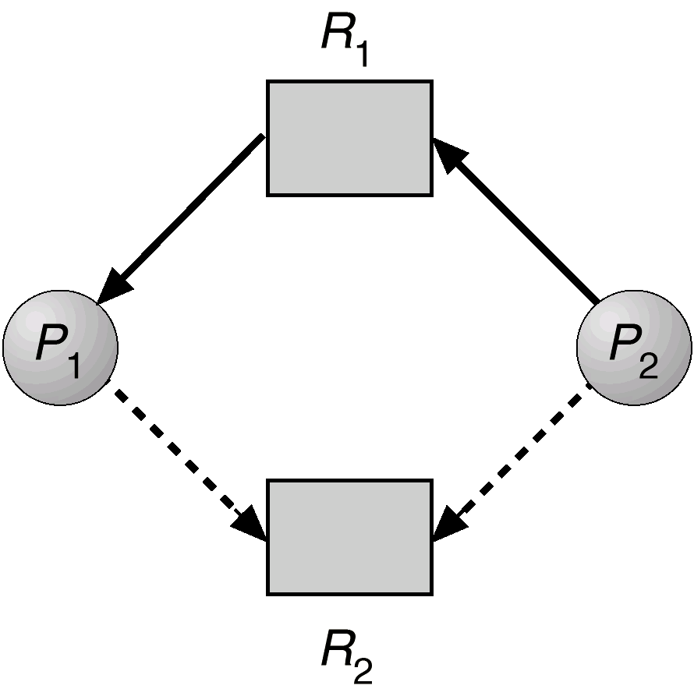
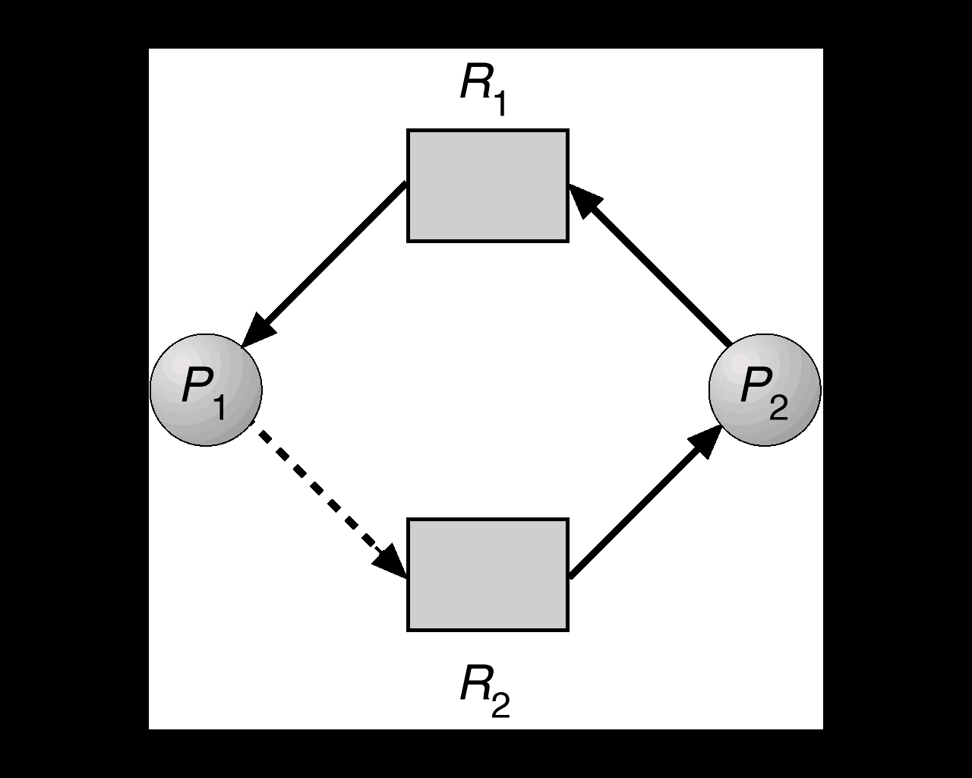
RAG Algorithm
Claim edge is converted to request edge, and then to assignment edge
Before converting claim edge to request edge, need to check whether it will create a cycle
in directed Graph, or not
42

Slide 43
Banker’s Algorithm
For multiple resources, with multiple instances
When process makes a resource request, algorithm checks…
“whether after grant of request,
system will remain in Safe state or not;
if yes request is granted, if not request is denied”
  (algo is based on resource denial, if risk of deadlock)
Each process must declare its resource requirement in advance
  when process requests a resource…
    may have to wait → if allocation results in Unsafe state
  when process gets all its resources…
    must return them in finite amount of time
Banker’s Algo comprises: Resource Request algo & Safety algo
43

Slide 44
Data Structures used
n = Number of processes m = Number of resource types
Max: n x m matrix, indicates max need of resources by each process
Max [i,j] = k – P_{i} may request at most k instances of R_{j}
Allocation: n x m matrix, indicates number of currently allocated instances of each resource type to each process
Allocation [i,j] = k – P_{i} is currently allocated k instances of R_{j}
Need: n x m matrix, indicates remaining resource need of each process
Need [i,j] = k – P_{i} needs k more instances of R_{j}
Need [i,j] = Max [i,j] – Allocation [i,j]
Available: vector of length m, indicates number of currently available instances of each resource type
Available [j] = k – resource type R_{j} has k instances available
44

Slide 45
Resource Request Algorithm
Let request vector for process P_{i} be → Request_{i} [j] = k
  If Request_{i} ≤ Need_{i} then
    go to step 2
    else
    report error (process exceeded its max claim)
  If Request_{i} ≤ Available then
    go to step 3
    else
    P_{i} must wait (resources not available)
  Update system state:
      Available = Available – Request_{i};
      Allocation_{i} = Allocation_{i} + Request_{i};
      Need_{i} = Need_{i} – Request_{i};
45

Slide 46
Resource Request Algorithm
Now invoke Safety algo with this new system state
Safety algo tells Banking algo whether new state is safe or not
  If Safe ⇒ resources are allocated to P_{i}
  if Unsafe ⇒ P_{i} must wait,
  old resource allocation state is restored
46

Slide 47
Safety Algorithm
Used to determine whether system is in Safe state
  check system state
  is there any process whose resource request can be met
  if yes, note it down in safe sequence
  then add its allocation vector to available vector
  we get a new available vector, with some new instances of various resource types
  (repeat above steps for all processes)
Finally, either we are able to :
  finish all processes with a safe sequence, OR
  we may get stuck
Safety algo returns → Safe or Unsafe (whatever is applicable)
47

Slide 48
Sample Problem 1
Five processes: P₀ … P₄
Three resource types: A (10 instances), B (5 instances), C (7 instances)
System state is shown below:
Process
P₀
P₁
P₂
P₃
P₄
Max Matrix
A B C
7 5 3
3 2 2
9 0 2
2 2 2
4 3 3
Allocation Matrix
A B C
0 1 0
2 0 0
3 0 2
2 1 1
0 0 2
Available Vector
A | B | C
3 | 3 | 2
48

Slide 49
Sample Problem 1
Need_{i} = Max_{i} – Allocation_{i}
Need matrix
Process | A | B | C
P₀ | 7 | 4 | 3
P₁ | 1 | 2 | 2
P₂ | 6 | 0 | 0
P₃ | 0 | 1 | 1
P₄ | 4 | 3 | 1
49

Slide 50
Sample Problem 1
Process
P₀
P₁
P₂
P₃
P₄
Need
A B C
7 4 3
1 2 2
6 0 0
0 1 1
4 3 1
Allocation
A B C
0 1 0
2 0 0
3 0 2
2 1 1
0 0 2
Available
A | B | C
3 | 3 | 2
Safe Sequence: <>
50

Slide 51
Sample Problem 1
Process
P₀
P₁
P₂
P₃
P₄
Need
A B C
7 4 3
1 2 2
6 0 0
0 1 1
4 3 1
Allocation
A B C
0 1 0
2 0 0
3 0 2
2 1 1
0 0 2
Available
A | B | C
3 | 3 | 2
5 | 3 | 2
Safe Sequence: <P1>
51

Slide 52
Sample Problem 1
Process
P₀
P₁
P₂
P₃
P₄
Need
A B C
7 4 3
1 2 2
6 0 0
0 1 1
4 3 1
Allocation
A B C
0 1 0
2 0 0
3 0 2
2 1 1
0 0 2
Available
A | B | C
3 | 3 | 2
5 | 3 | 2
7 | 4 | 3
Safe Sequence: <P1, P3>
52

Slide 53
Sample Problem 1
Process
P₀
P₁
P₂
P₃
P₄
Need
A B C
7 4 3
1 2 2
6 0 0
0 1 1
4 3 1
Allocation
A B C
0 1 0
2 0 0
3 0 2
2 1 1
0 0 2
Available
A | B | C
3 | 3 | 2
5 | 3 | 2
7 | 4 | 3
7 | 4 | 5
Safe Sequence: <P1, P3, P4>
53

Slide 54
Sample Problem 1
Process
P₀
P₁
P₂
P₃
P₄
Need
A B C
7 4 3
1 2 2
6 0 0
0 1 1
4 3 1
Allocation
A B C
0 1 0
2 0 0
3 0 2
2 1 1
0 0 2
Available
A | B | C
3 | 3 | 2
5 | 3 | 2
7 | 4 | 3
7 | 4 | 5
7 | 5 | 5
Safe Sequence: <P1, P3, P4, P0>
54

Slide 55
Sample Problem 1
Process
P₀
P₁
P₂
P₃
P₄
Need
A B C
7 4 3
1 2 2
6 0 0
0 1 1
4 3 1
Allocation
A B C
0 1 0
2 0 0
3 0 2
2 1 1
0 0 2
Available
A | B | C
3 | 3 | 2
5 | 3 | 2
7 | 4 | 3
7 | 4 | 5
7 | 5 | 5
Safe Sequence: <P1, P3, P4, P0, P2>
55

Slide 56
Sample Problem 1
Final safe sequence:
<P1, P3, P4, P0, P2>
Not a unique sequence
Possible safe sequences for this example:
<P1,P3,P4,P0,P2>, <P1,P3,P4,P2,P0>, <P1,P3,P2,P0,P4>,
<P1,P3,P2,P4,P0>, <P1,P3,P0,P2,P4>, <P1,P3,P0,P4,P2>
56

Slide 57
Sample Problem 2
Four processes: P₁ … P₄
Three resource types: A (9 instances), B (3 instances), C (6 instances)
System state is shown below:
Process
P₁
P₂
P₃
P₄
Max Matrix
A B C
3 2 2
6 1 3
3 1 4
4 2 2
Allocation Matrix
A B C
1 0 0
6 1 2
2 1 1
0 0 2
Available Vector
A | B | C
0 | 1 | 1
57

Slide 58
  Detection & Recovery
58

Slide 59
Deadlock Detection & Recovery
Deadlock prevention & avoidance result in…
  conservative allocation of resources
  related inefficiencies
Deadlock detection takes the opposite approach…
  make allocations liberally
  allow deadlock to occur (assumption → DL will be rare)
  then use following algos…
  Detection algo – check periodically for deadlocks
  Recovery algo – apply recovery, when necessary
59

Slide 60
Deadlock Detection Algo
(for Single Instance of each Resource Type)
Wait for Graph used to describe deadlocks:
  ‘wait for graph’ is derived from RAG – collapse resource nodes
  if P_{i} → P_{j} → P_{i} is waiting for P_{j}
  if cycle in ‘wait for graph’ → deadlock
For Deadlock detection:
  system maintains a wait for graph
  periodically invokes algo to search for cycles in wait for graph
Algo is simpler than RAG
  only includes process dependencies to detect cycles
60

Slide 61
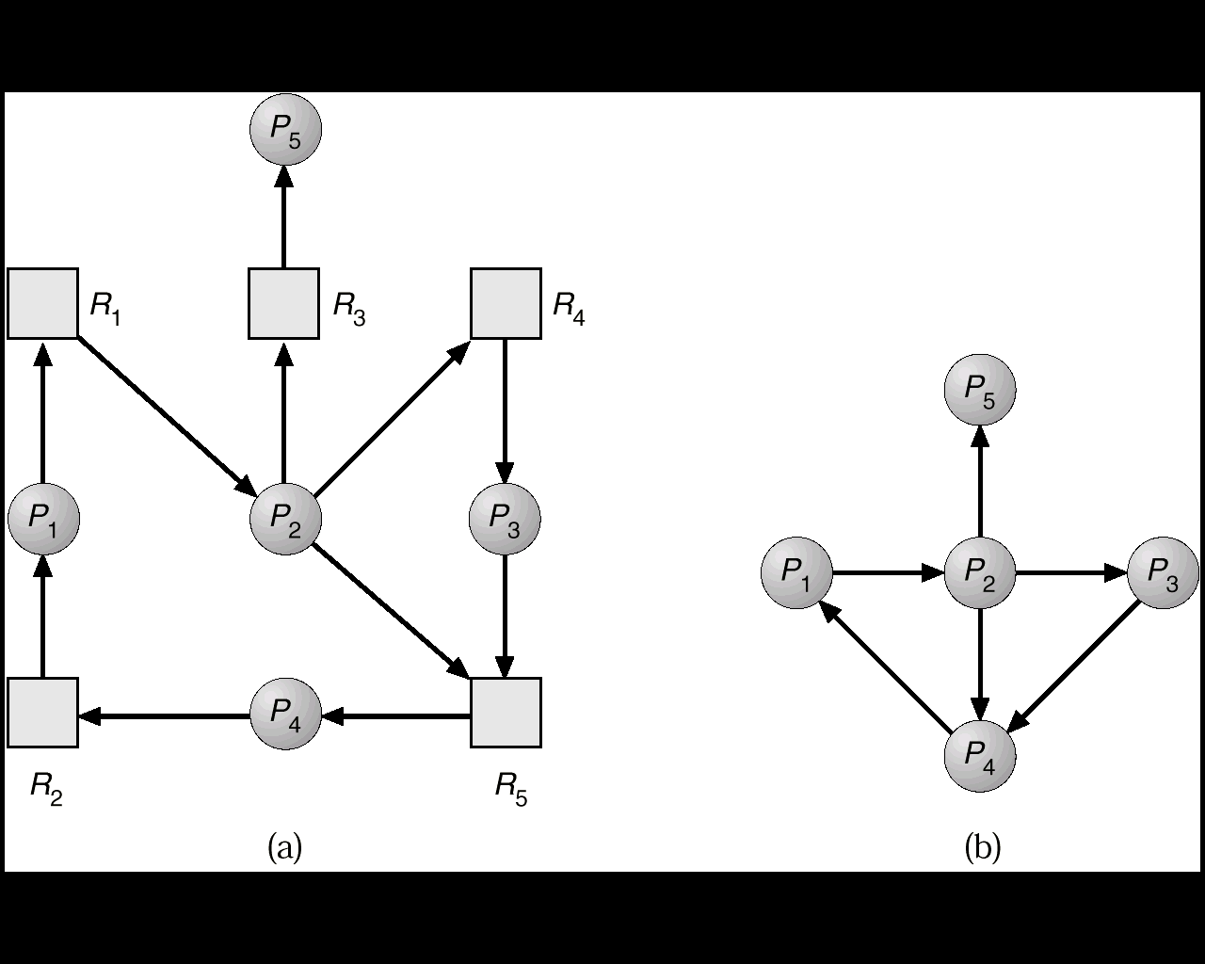
RAG & Wait for Graph
Resource Allocation Graph
Wait for Graph
61

Slide 62
Deadlock Detection
How often should detection algo be invoked…
When request for allocation can’t be granted immediately
  expensive, but process causing deadlock is identified
  along with other processes involved in deadlock
Other approaches…
  Monitor CPU usage – when usage is below certain level,
  invoke the algo
  Run periodically – after specified time intervals
  Run arbitrarily – at random times
may find a number of cycles in the system,
may not be able to find which process created the cycles
62

Slide 63
Deadlock Recovery
Recovery includes the following approaches…
    Abort all deadlocked processes
      though drastic, but probably most common approach
    Abort deadlocked processes, one at a time
      until no deadlock
    Rollback all deadlocked processes
      revert processes to a previous safe state
      rollback mechanisms potentially expensive
      also, original deadlock may recur
    Preempt resources
      until no deadlock
63

Slide 64
Deadlock Detection & Recovery
When detection algo determines that deadlock exists, it either:
  lets operator deal with deadlock manually, OR
  recovers from deadlock automatically
Two options for breaking a deadlock…
  Process Termination
  Resource Preemption
64

Slide 65
Deadlock Detection & Recovery
Process Termination
Abort all deadlocked processes
Abort one process at a time, until deadlock cycle eliminated
While selecting victim process, consider following issues:
  priority of process
  how long process has run
  is process interactive or batch
  resources already held by process
  additional resources needed to complete
  how many child processes will need to be terminated
65

Slide 66
Deadlock Detection & Recovery
Resource Preemption
select a process, & take back some resources
allocate these resources to other requesting processes
bring system out of deadlock
Three important issues to be considered:
Victim Selection – which process/resource to be preempted
Rollback – if resource preempted from a process
  need to rollback victim process to some safe state
  for restarting later
Starvation – possible to always pick the same process as victim
  include rollback count in cost factor of victim selection
66

